Slide 1
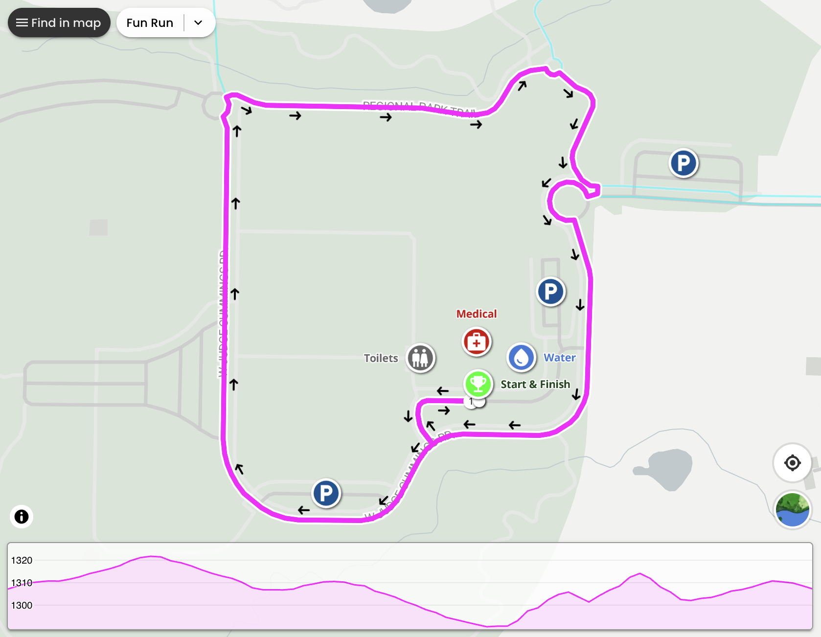
Fun Run Route (1 Mile) – Road Map

Slide 2
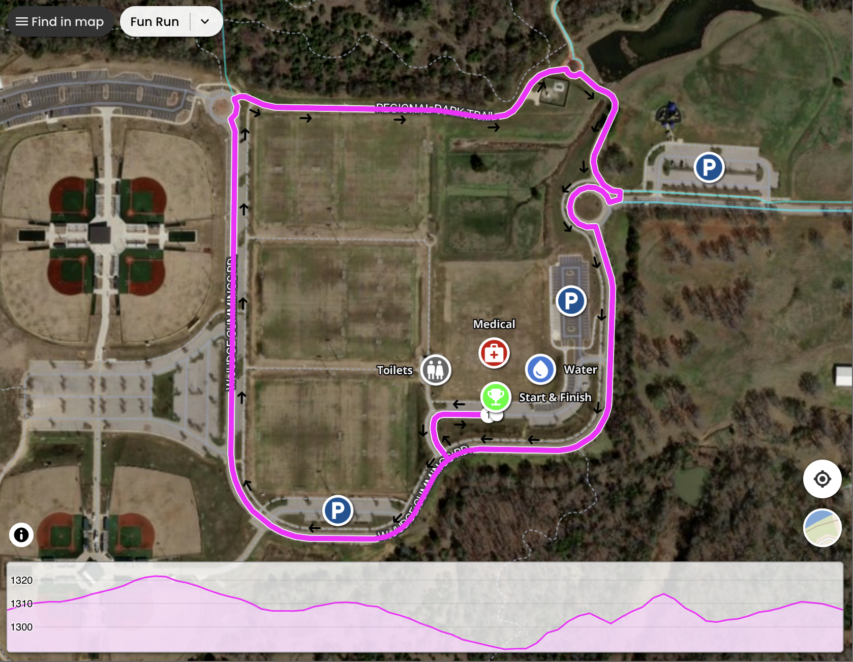
Fun Run Route (1 Mile) – Satellite

Slide 3
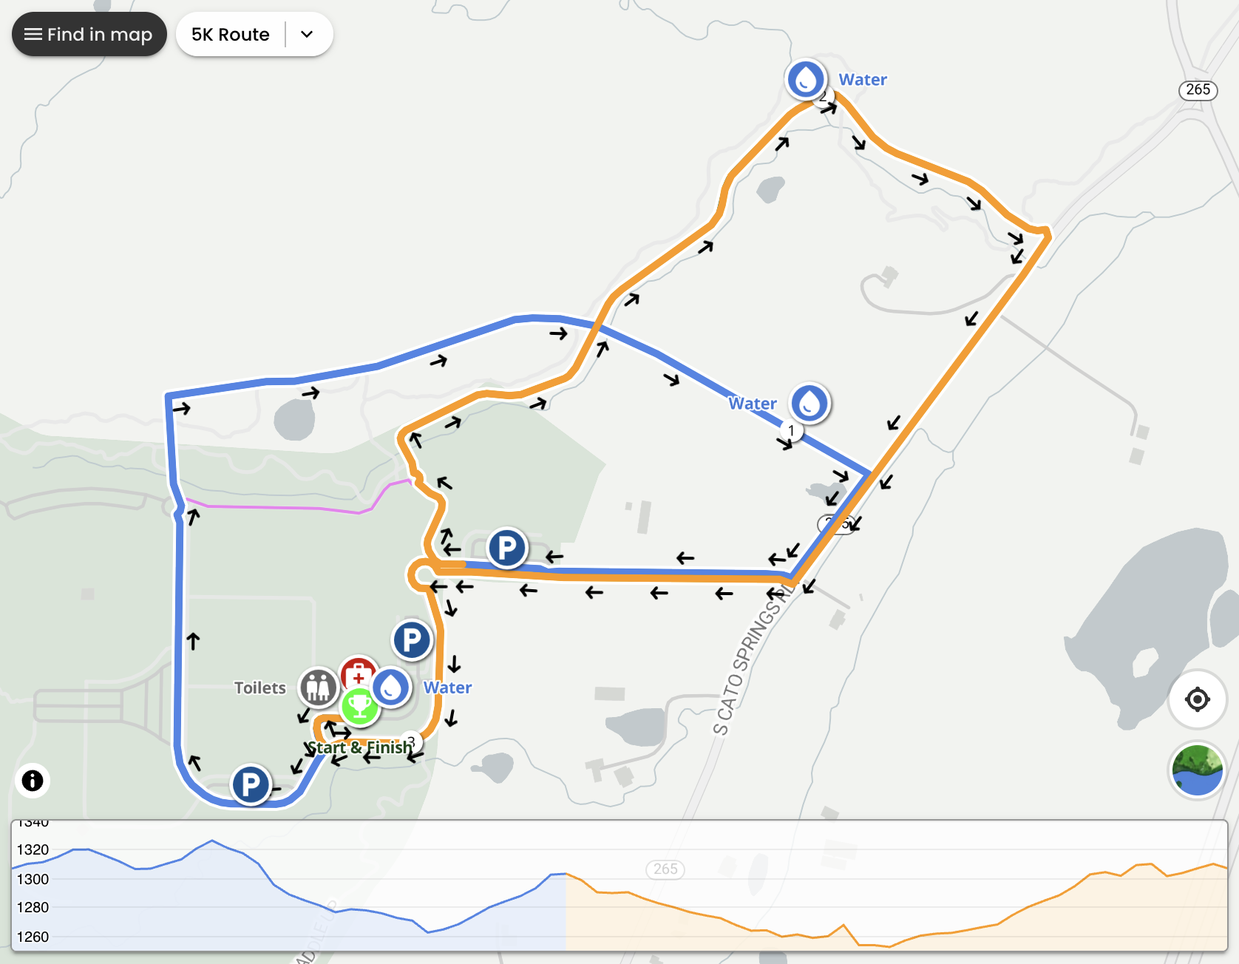
5K Route (3.1 Miles) – Road Map

Slide 4
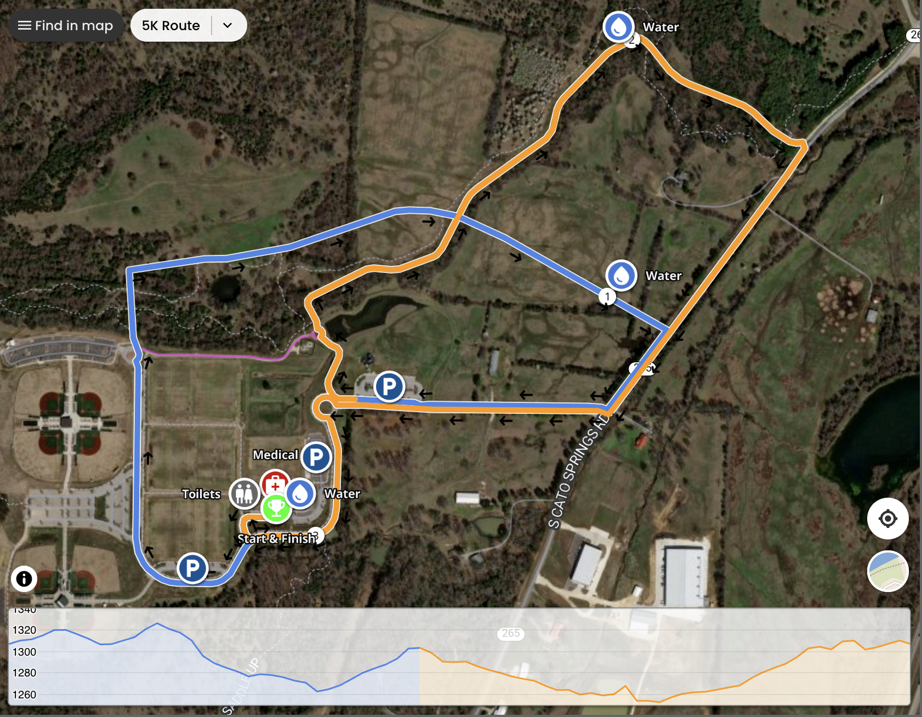
5K Route (3.1 Miles) – Satellite

